Slide 1
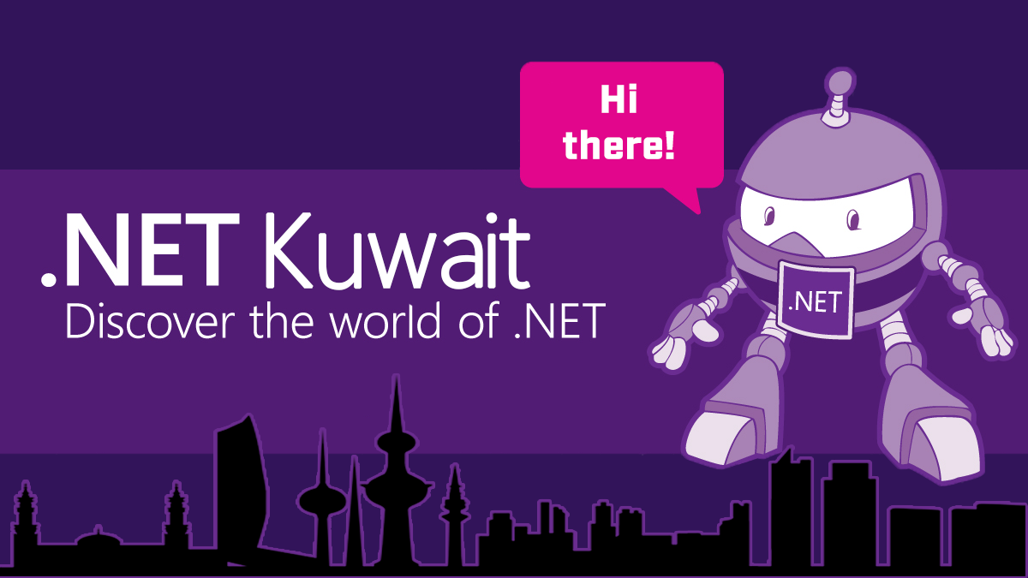
Migrate Web App to Azure
Amir Ismail
Tariq Abubaker

Slide 2
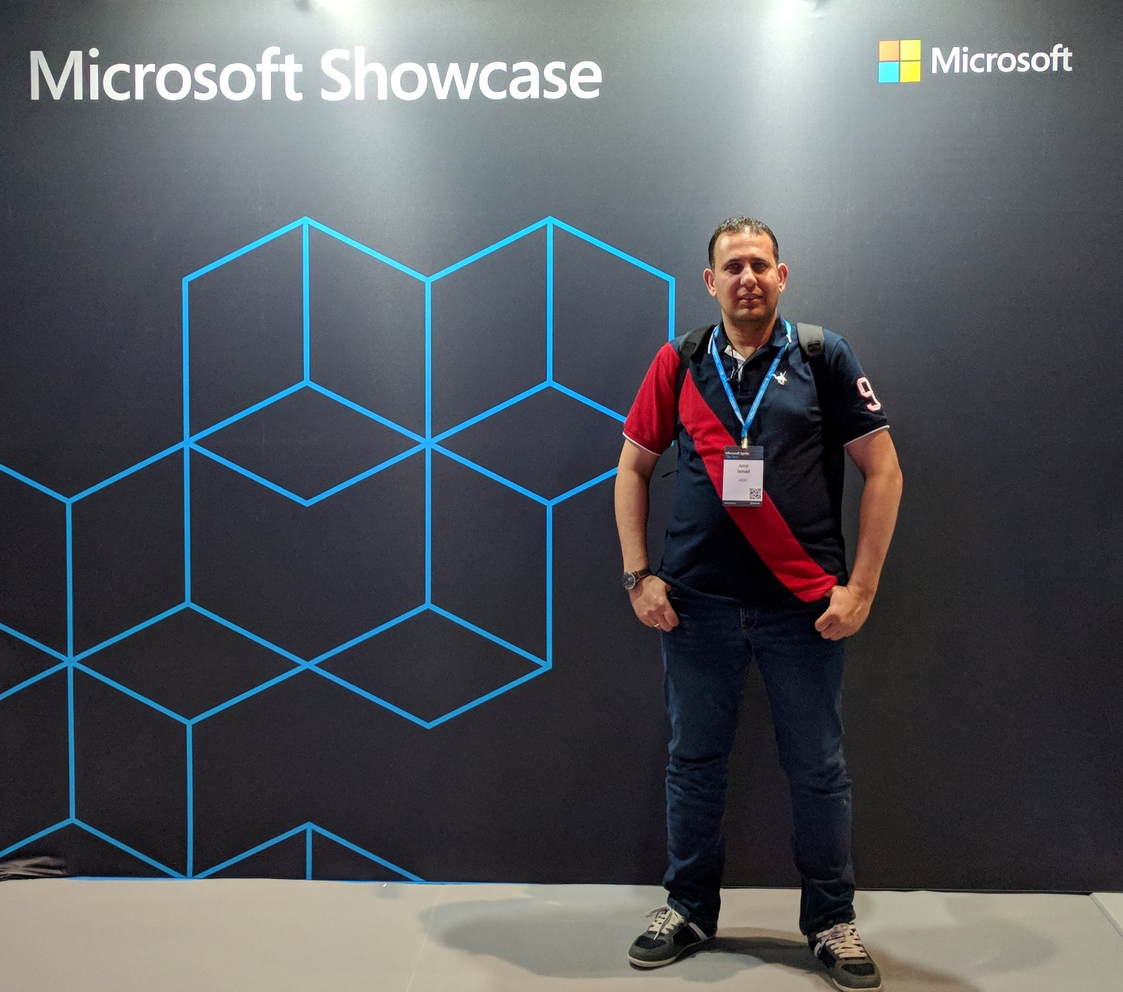


Amir Ismail
Overview
Senior Software Engineer for Kuwait Oil Company.
+15 years of experience in Software Engineering. I participated in multiple projects in different business domains range from E-learning, Banking, Oil, E-booing and Hotels management.
Certifications
PSM I Certified.
ITIL® Certified.
PRINCE2® Certified.
Contact Details
https://www.linkedin.com/in/amirismailyousef/
@miroprocessor

Slide 3
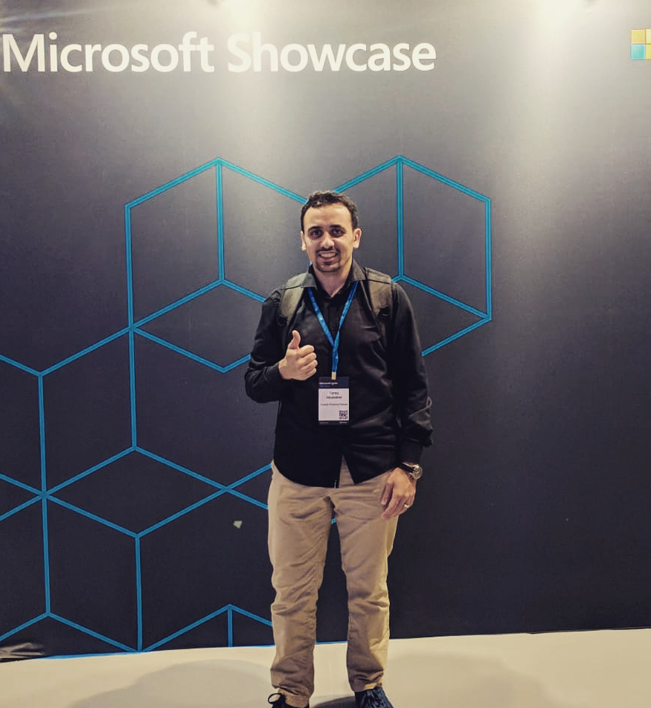
Tariq Abubaker
Overview
IT Enterprise Architect for Kuwait Finance House.
+10 years of experience in the IT and banking industry. I participated multiple projects range from SOA, EA, Core banking, Payment Solutions, Credit Cards, AML and Fraud, CRM, Retail, Finance, and IT service management solutions.
Certifications
TOGAF® 9 Certified.
DevOps Certified.
MCTS: .NET Framework 4, Web Applications.
MCP
Contact Details
https://www.linkedin.com/in/tariq-abubaker/
@taq_abubaker

Slide 4
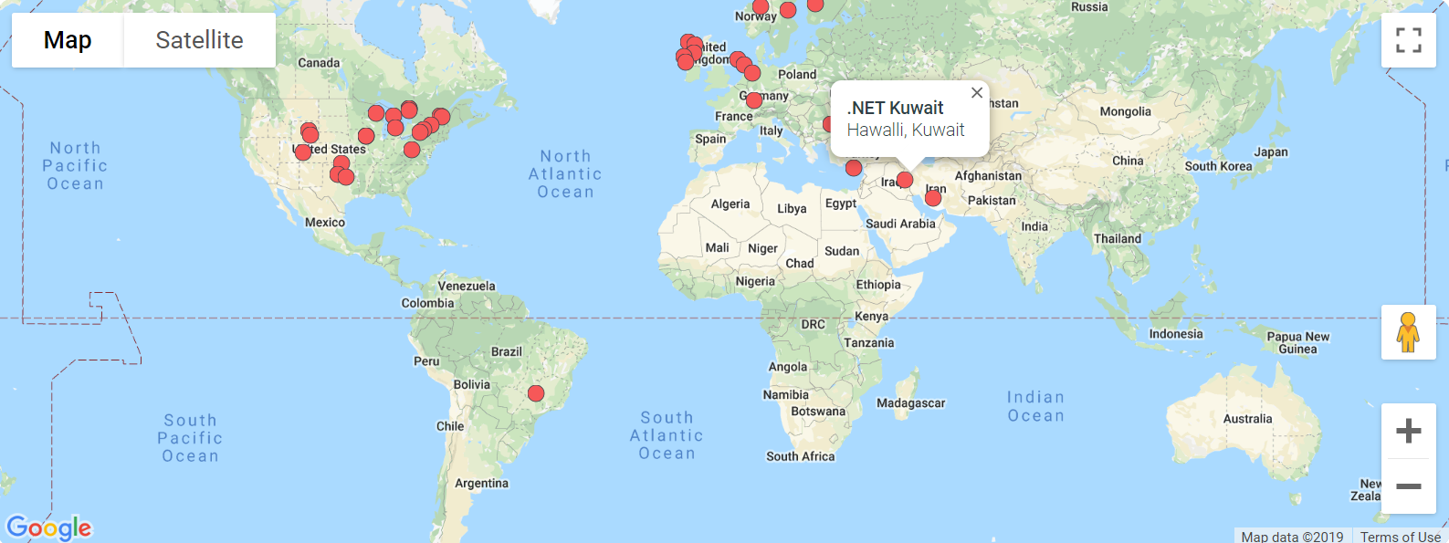
Last Month Update
Become member of Azure Tech Communities

Slide 5
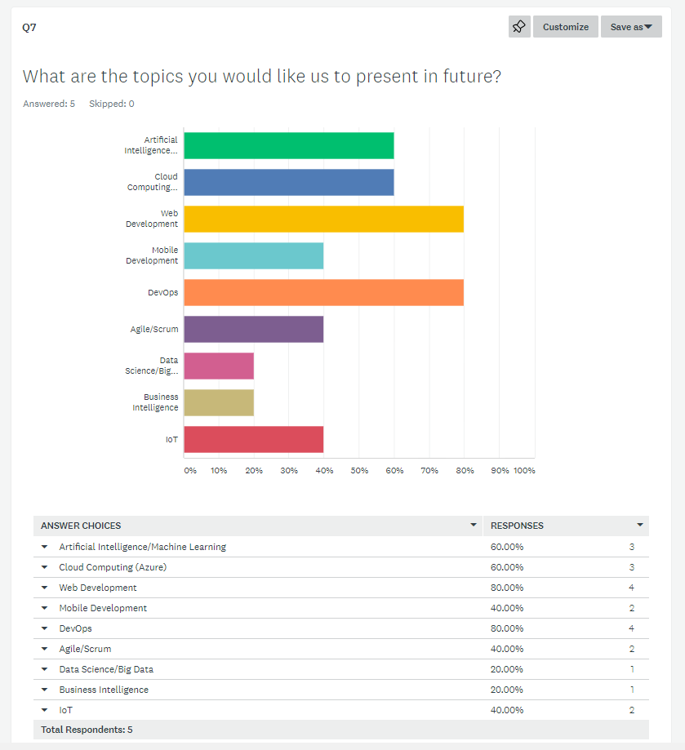
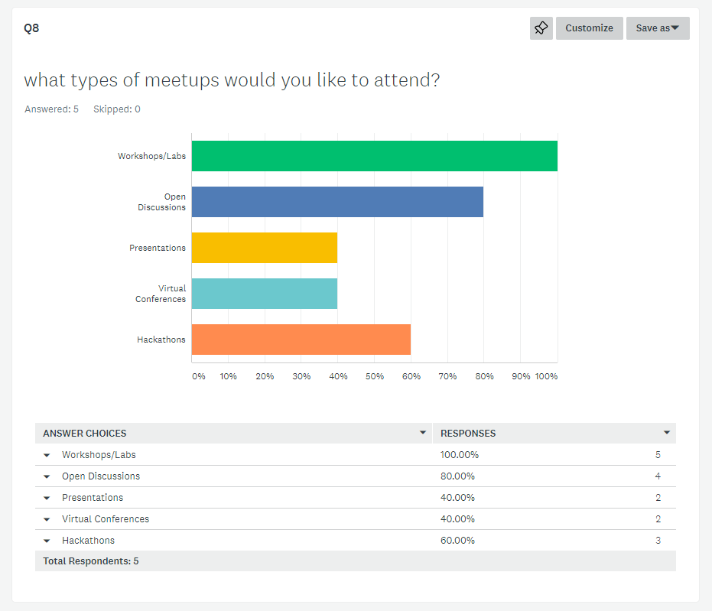
Results from last survey
5 out of the 13 completed the survey which is 38% response rate.

Slide 6

What is cloud computing?
Cloud computing is renting resources.
Cloud provider is responsible for the physical hardware required.
The computing services offered by cloud provider typically include
Compute power - such as Linux servers or web applications
Storage - such as files and databases
Networking - such as secure connections between the cloud provider and your company
Analytics - such as visualizing telemetry and performance data
6

Slide 7
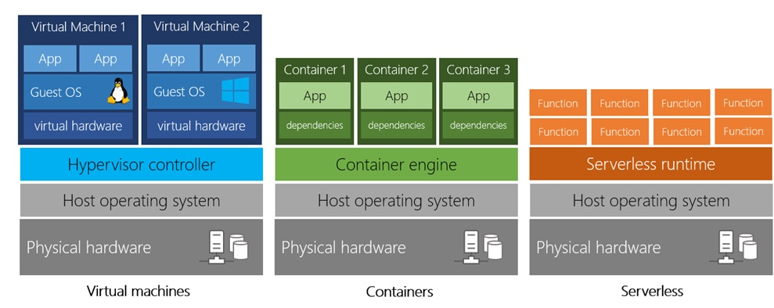
Types of Compute Power
Virtual Machines – VMs
Like a physical computer, includes operating system and hardware.
You can Install whatever software you want.
Gives more control over and responsibilities over maintenance.

Slide 8
Types of Compute Power
Containers (ex: Docker)
Provide a consistent, isolated execution environment for applications.
Similar to VMs except they don't require a guest operating system(no boot time).
The application and all its dependencies is packaged into a "container" and then a standard runtime environment is used to execute the app.

Slide 9
Types of Compute Power
Serverless Computing
Run application code without creating, configuring, or maintaining a server.
You only pay for the processing time used by each function as it executes

Slide 10
Benefits of cloud computing
Cost Effective
No upfront infrastructure costs.
Scalability
As your workload changes due to a spike or drop in demand, a cloud computing system can compensate by automatically adding or removing resources
Current
Focus on building and deploying applications.
Elasticity
No need to purchase infrastructure may not be used.
The ability to pay for additionally resources when they are needed.
The ability to stop paying for resources that are no longer needed.
It can be done manually or automatically based on specific triggers.
Horizontal Scaling(scaling out) adding more servers(VMs) that function together as one unit.
Vertical Scaling(scaling up) adding more resources to the existing server(VM).
Use the latest software and tools.
Maintaining software patches, hardware setup, upgrades automatically done for.
Scale by Edanur Kuntman, Resilience by Attilio Baghino, cloud okay by Weltenraser from the Noun Project

Slide 11
Benefits of cloud computing
Reliable
Your data is always going to be there. Azure offers data backup, disaster recovery, and data replication services Redundancy is built into cloud services architecture so if one component fails, a backup component takes its place.
Global
Azure is secured with multi-levels of security starting from physical security for accessing data centers building to encrypting your data and files.
Secure
Azure has fully redundant datacenters around the globe in different regions.
reliable by Nithinan Tatah, global by wardehpillai from the Noun Project and secure by Vectorstall from the Noun Project

Slide 12
Cloud Deployment Models
Public
Private
Hybrid
Cloud provider is managing and maintaining your resources.
Ex.: Azure, AWS, and Google Cloud.
Your are responsible for managing and maintaining hardware and security.
Allows you run your application in most appropriate location.
You have no local hardware
Your create your own cloud environment in you datacenter.
It combines the public and private clouds.
Each model has its own pros and cons. The selection is based on your business requirement and restrictions.

Slide 13
Types of cloud services
Infrastructure as a Service(IaaS)
It provides the hardware and operating system. It can be used in
Platform as a Service(PaaS)
Its goal is helping you create an application quickly without managing the underlying infrastructure. It is commonly used in following scenarios
Development Framework.
Software as a Service(SaaS)
It is centrally hosted and managed for end user like Dynamics CRM, Skype, and office 365.
Migrating work loads.
Test and development.
Storage, backup, and recovery.
Analytics or business intelligence.
reliable by Nithinan Tatah, global by wardehpillai from the Noun Project and secure by Vectorstall from the Noun Project

Slide 14
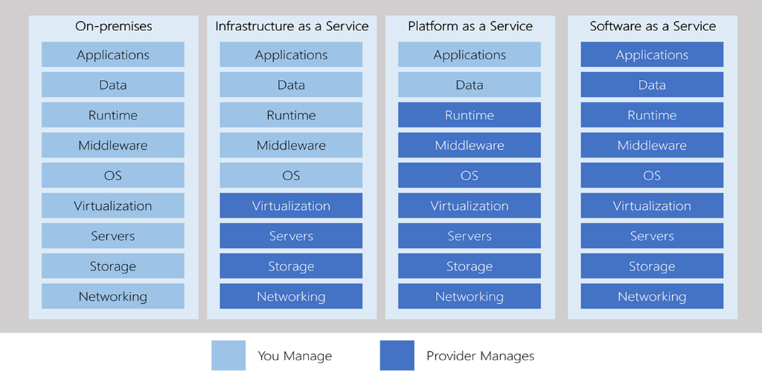
Types of cloud services – Management Responsibilities

Slide 15
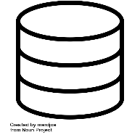
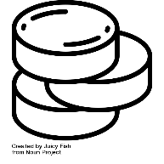
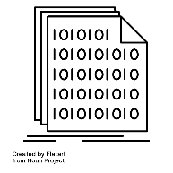
Types of Azure Data Storage
Structured Data
(relational data)
Adheres to a schema, so all of the data has the same fields or properties.
Semi-Structured data
(non-relational or NoSQL)
Uses tags or Keys instead of tables, rows and columns .
Unstructured Data
Has no designated structure.
Can be stored in a database table with row and columns.
Easy to enter, query, and analyze.
All data follows the same format.
Tags or keys are organized in a hierarchy (Documents).
No restrictions on the kind of data it can hold.
Becoming more prominent as business try to tap to a new data source.
Ex: PDFs, media files, JSON files.
database by mardjoe, Unstructured Data by Juicy Fish, binary file by Flatart from the Noun Project

Slide 16
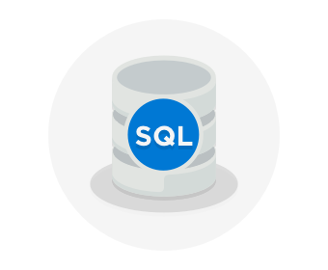
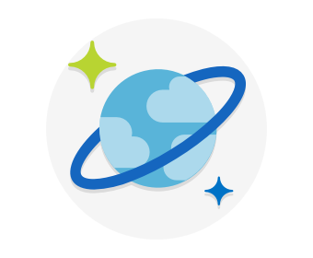
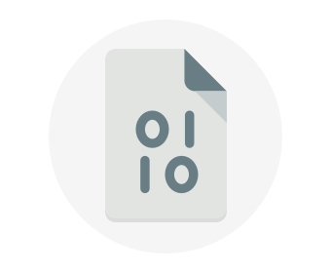
Azure Data Storage Options
Azure SQL Database
Relational database as a service (DaaS).
Latest stable version of MS SQL Server.
Migrate existing DBs to Azure SQL using Azure database Migration Service.
Microsoft Data Migration Assistant generate recommendation report.
Just change the connection string in your Application.
Azure CosmosDB
Distributed database service.
Supports schema-less (NoSQL) data.
Azure Blob Storage
Unstructured which means no restriction on the kind of data.
Highly scalable.
Reached from anywhere.
Ability to store up to 8 TB of data for virtual machines.

Slide 17
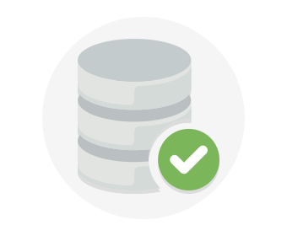
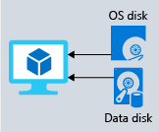
Azure Data Storage Options
Disk Storage
Provides disks for virtual machines and applications to access and use as they need.
Allows data to be stored and accessed from the attached virtual hard disk.
Disks can be managed by azure and managed and configured by user.
Used in lift and shift scenarios or for storing data that is not accessed from outside
the virtual machine.
Different sizes and type (SSD & HDD)

Slide 18
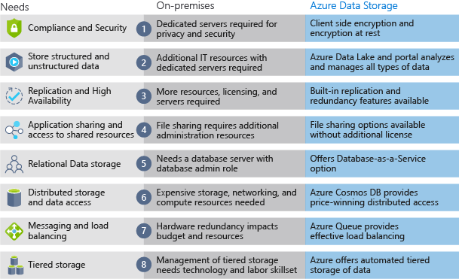
On-Premises vs Azure Storage
Cost Effectiveness
Reliability
Storage Types
Agility

Slide 19
Cloud Maturity Model
Existing apps
on-prem
Lift and Shift
Lift & Shift
Minimal code-changes
Slide by Corey Sanders @CoreySandersWA
19

Slide 20



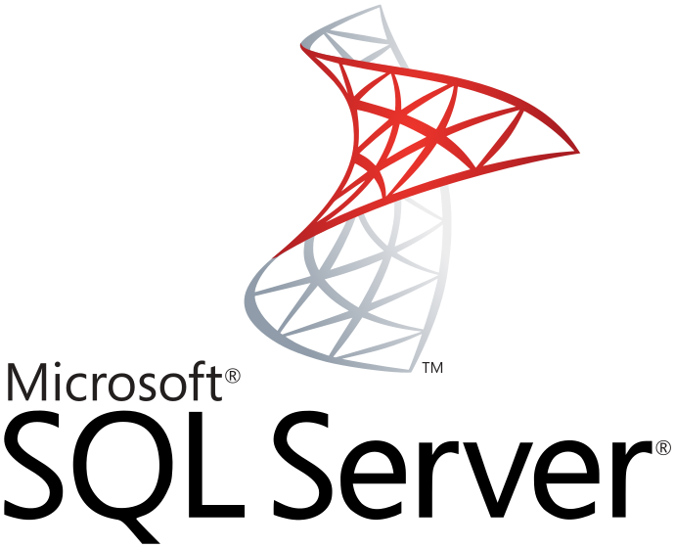

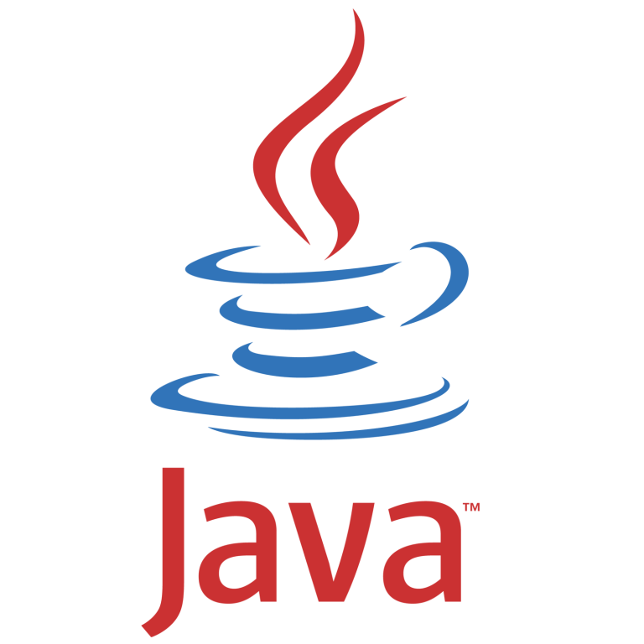


Lift and Shift Migrate your on-premise application to IaaS on Azure
Pros
Existing Apps
Web apps (on-prem.)
Lift & Shift
Web apps (Cloud)
No re-architect or new code
Least effort for quick migration
Supported on the least common denominator
On-Premises
IaaS Cloud (VMs)
Cons
Smaller cloud value
Manual patching, upgrades
Limited automated app scaling and high availability
Monolithic architecture
Monolithic architecture
Slide by Corey Sanders @CoreySandersWA
20

Slide 21
Cloud Maturity Model
Existing apps
on-prem
Lift and Shift
Cloud optimized
Lift & Shift
Minimal code-changes
Slide by Corey Sanders @CoreySandersWA
21

Slide 22

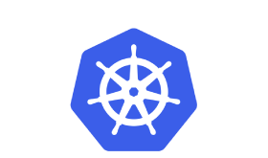

Cloud Optimized Get more Cloud benefit by Containerizing your app
Lift & Shift
Web apps (Cloud)
Pros
Existing apps
Web apps (on-prem.)
Orchestration and Managed Services
No re-architect or new code
Increased density & lower deployment cost
Improved productivity and DevOps agility
Portability of apps and dependencies
High availability with Orchestrators
On-Premises
Cons
Containerization is an additional step
Monolithic architecture
Slide by Corey Sanders @CoreySandersWA
22

Slide 23
Cloud Maturity Model
Existing apps
on-prem
Lift and Shift
Cloud optimized
App modernized
Architected for the cloud
modernized/refactor/rewrite
Slide by Corey Sanders @CoreySandersWA
23

Slide 24
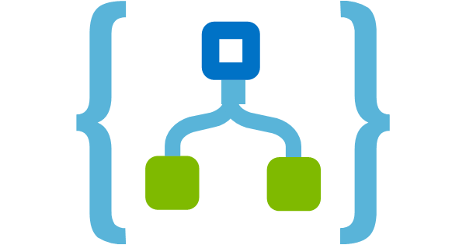
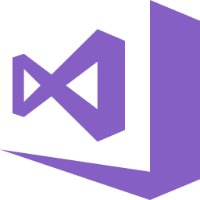


App Modernized Extend your apps with new cloud native services including serverless, microservices and PaaS.
Cloud-optimized full PaaS
Pros
Existing apps
Web apps (on-prem.)
Optimized for long term agility
Optimized for scale and high availability
Modern Architecture with Microservices
On-Premises
Cons
Requires significant code refactoring or rewriting
Monolithic architecture
Microservice architecture
Slide by Corey Sanders @CoreySandersWA
24

Slide 25
Cloud Maturity Model
Existing apps
on-prem
Lift and Shift
Cloud optimized
App modernized
Lift & Shift
Minimal code-changes
Architected for the cloud
modernized/refactor/rewrite
Slide by Corey Sanders @CoreySandersWA
25

Slide 26
Migrating Web App to Azure.
Create an account on Azure(SKIP)
Create a subscription(SKIP)
Create a resource group
Managed by Azure Resource Manager (ARM)
Create a VM.
Create an App Service.
Create a website hosted in Azure
Storage

Slide 27
Demo

Slide 28
Resources
https://docs.microsoft.com/en-us/learn/paths/azure-fundamentals/
https://docs.microsoft.com/en-us/learn/modules/provision-azure-sql-db
https://docs.microsoft.com/en-us/learn/modules/develop-app-that-queries-azure-sql/
https://docs.microsoft.com/en-us/learn/modules/prepare-your-dev-environment-for-azure-development
https://docs.microsoft.com/en-us/learn/modules/host-a-web-app-with-azure-app-service
https://docs.microsoft.com/en-us/learn/modules/publish-azure-web-app-with-visual-studio

Slide 29



Contact Us
@dotnetkw
@dotnetkw
.Net Kuwait

Slide 30

SCAN THE CODE & START YOUR Migration today
https://aka.ms/AA6923d
30

Slide 31

SCAN THE CODE & SEND US YOUR FEEDBACK!
http://bit.ly/2pDgRit
31

Slide 32

Thank You
Let’s have a Group Photo!

